Slide 1
My tree is the not a tree
Non tree like evolution

Slide 2
Phylogenetic tree approximate the transmission history

Slide 3
Processes, such as co-infection can lead to a person carrying pathogens from more than one source

Slide 4
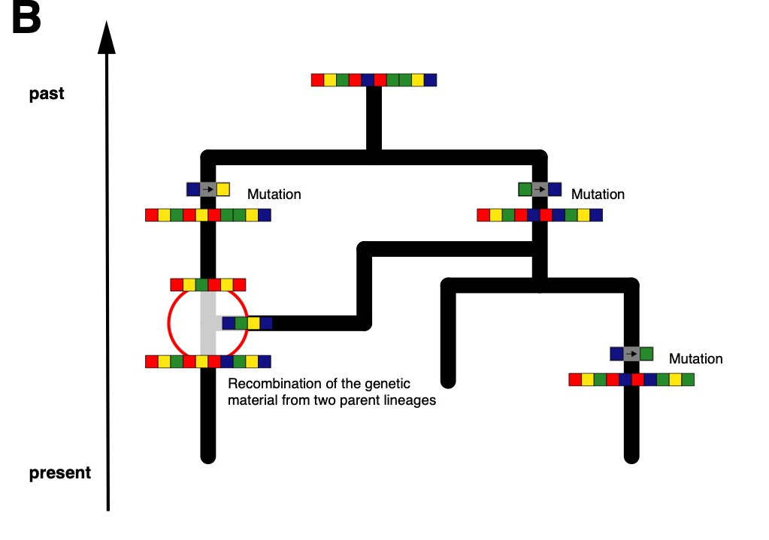
The combined genetic material may represent a network and not a tree

Slide 5
Genetic recombination processes lead to different parts of a genome coding for different histories

Slide 6
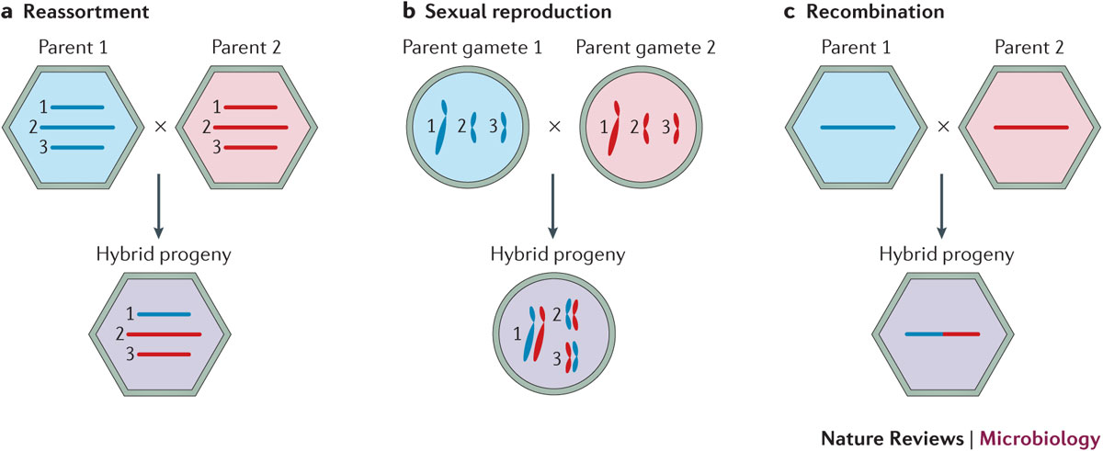
Different processes to “mix” genetic materials from two parent lineages exist
McDonald et al., 2016, Nat. Rev. Micr.

Slide 7
Ways to deal with recombination
Only use small parts of the genome that code for the same tree
Consider different parts of a genome to be independent.
Just ignore recombination.
Infer networks instead of trees (Part 2 of the lecture).

Slide 8
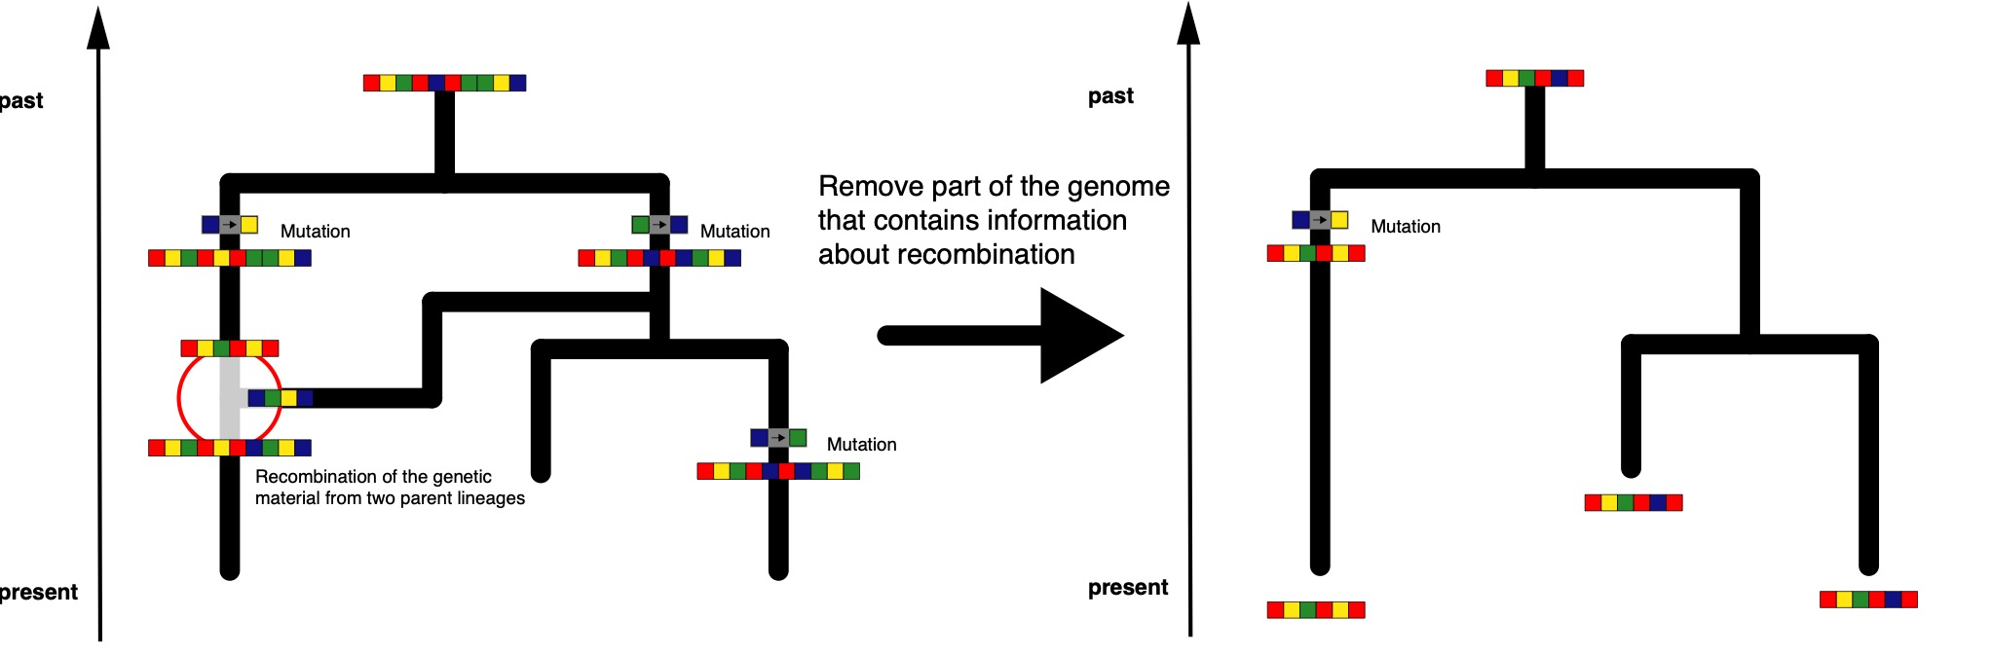
Only use small parts of the genome that code for the same tree.

Slide 9
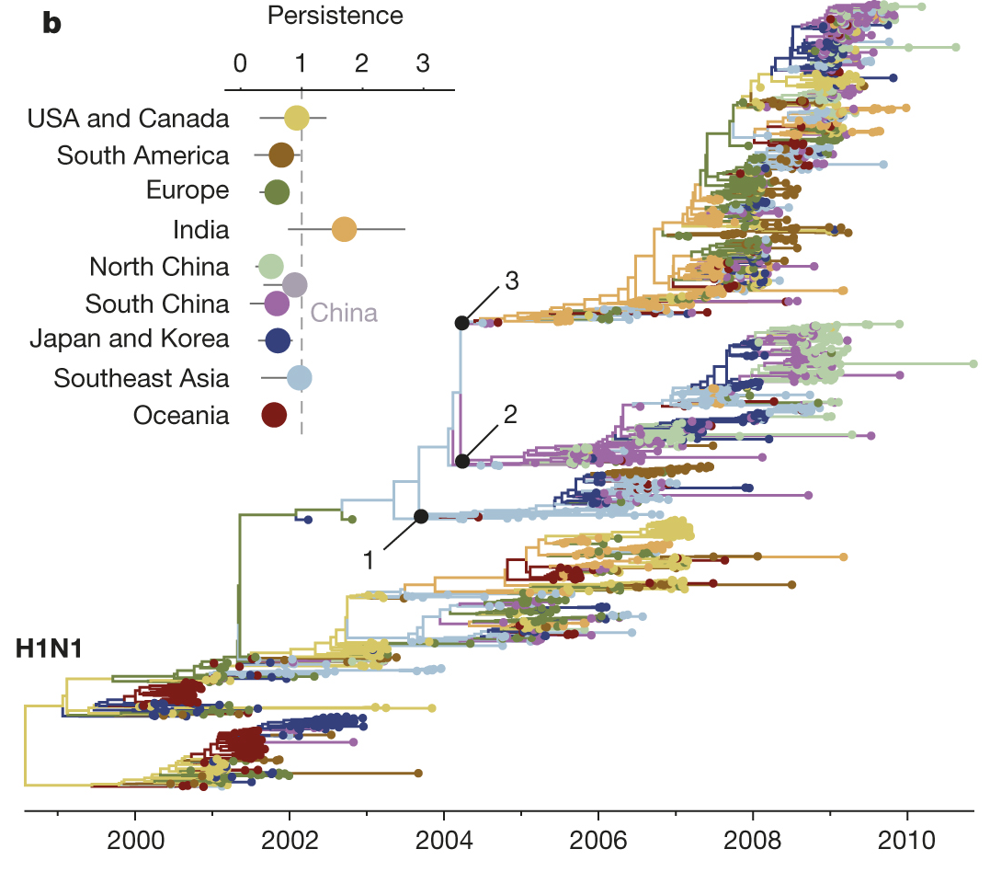
Population dynamics can be inferred from individual influenza segments
Bedford et al., 2015, Nature

Slide 10
When the recombination breakpoints are unknown, they are often estimated before an analysis
Estimate where recombination breakpoints are using e.g. RDP (Martin et. al, 2014, Virus Evolution)
Only use genetic sequences between these breakpoints for analysis

Slide 11
Using subsets of alignments reduces how well we can resolve phylogenetic trees
Dudas et al., 2019, BMC Evol. Bio.

Slide 12
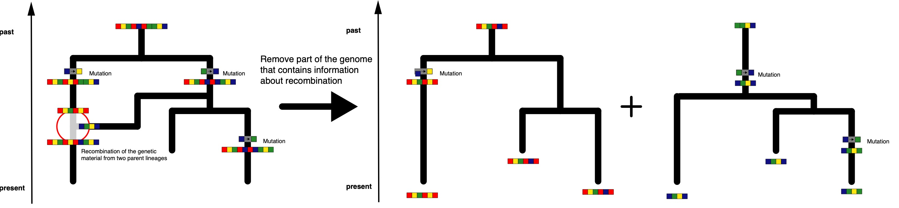
Consider different parts of a genome to be independent.

Slide 13
Independent loci can give information about events further in the past
Heled et al., 2008, BMC Evol. Bio.

Slide 14
More tips are likely to coalesce quickly, more trees on the other hand give more information about past events
Heled et al., 2008, BMC Evol. Bio.

Slide 15
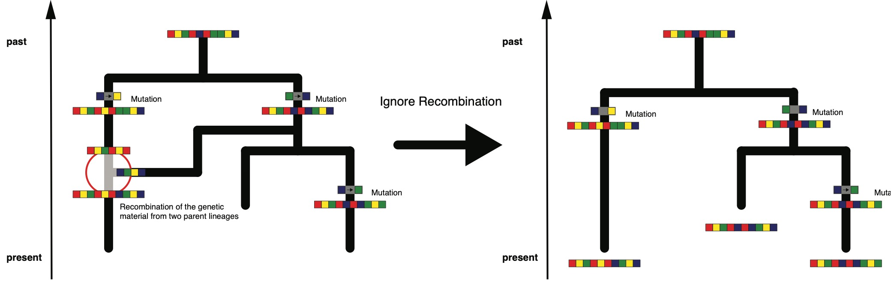
Just ignore recombination.

Slide 16
QUESTIONS?

Slide 17
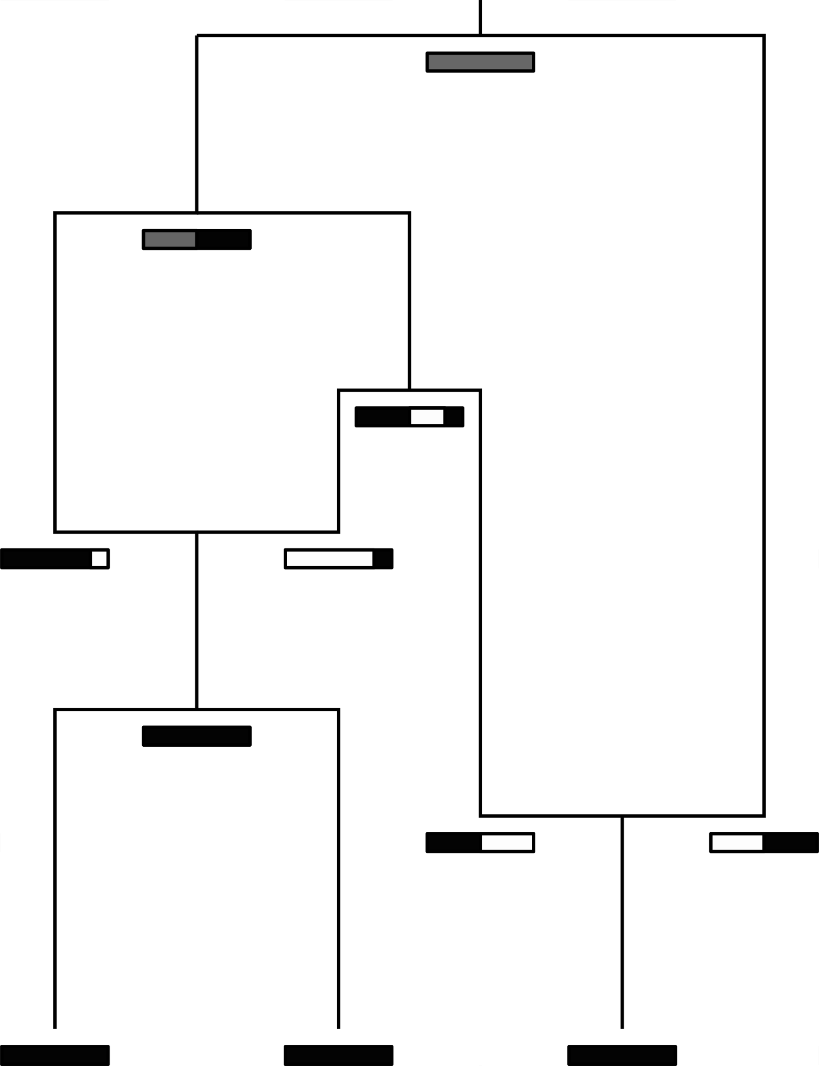
The coalescent with gene conversion models how lineages coalesce (Wiuf and Hein, 2000)
Coalescent rate is given by 1/Ne
Recombination rate is r
Recombination breakpoints uniformly chosen across alignment
Slide from Tim Vaughan

Slide 18
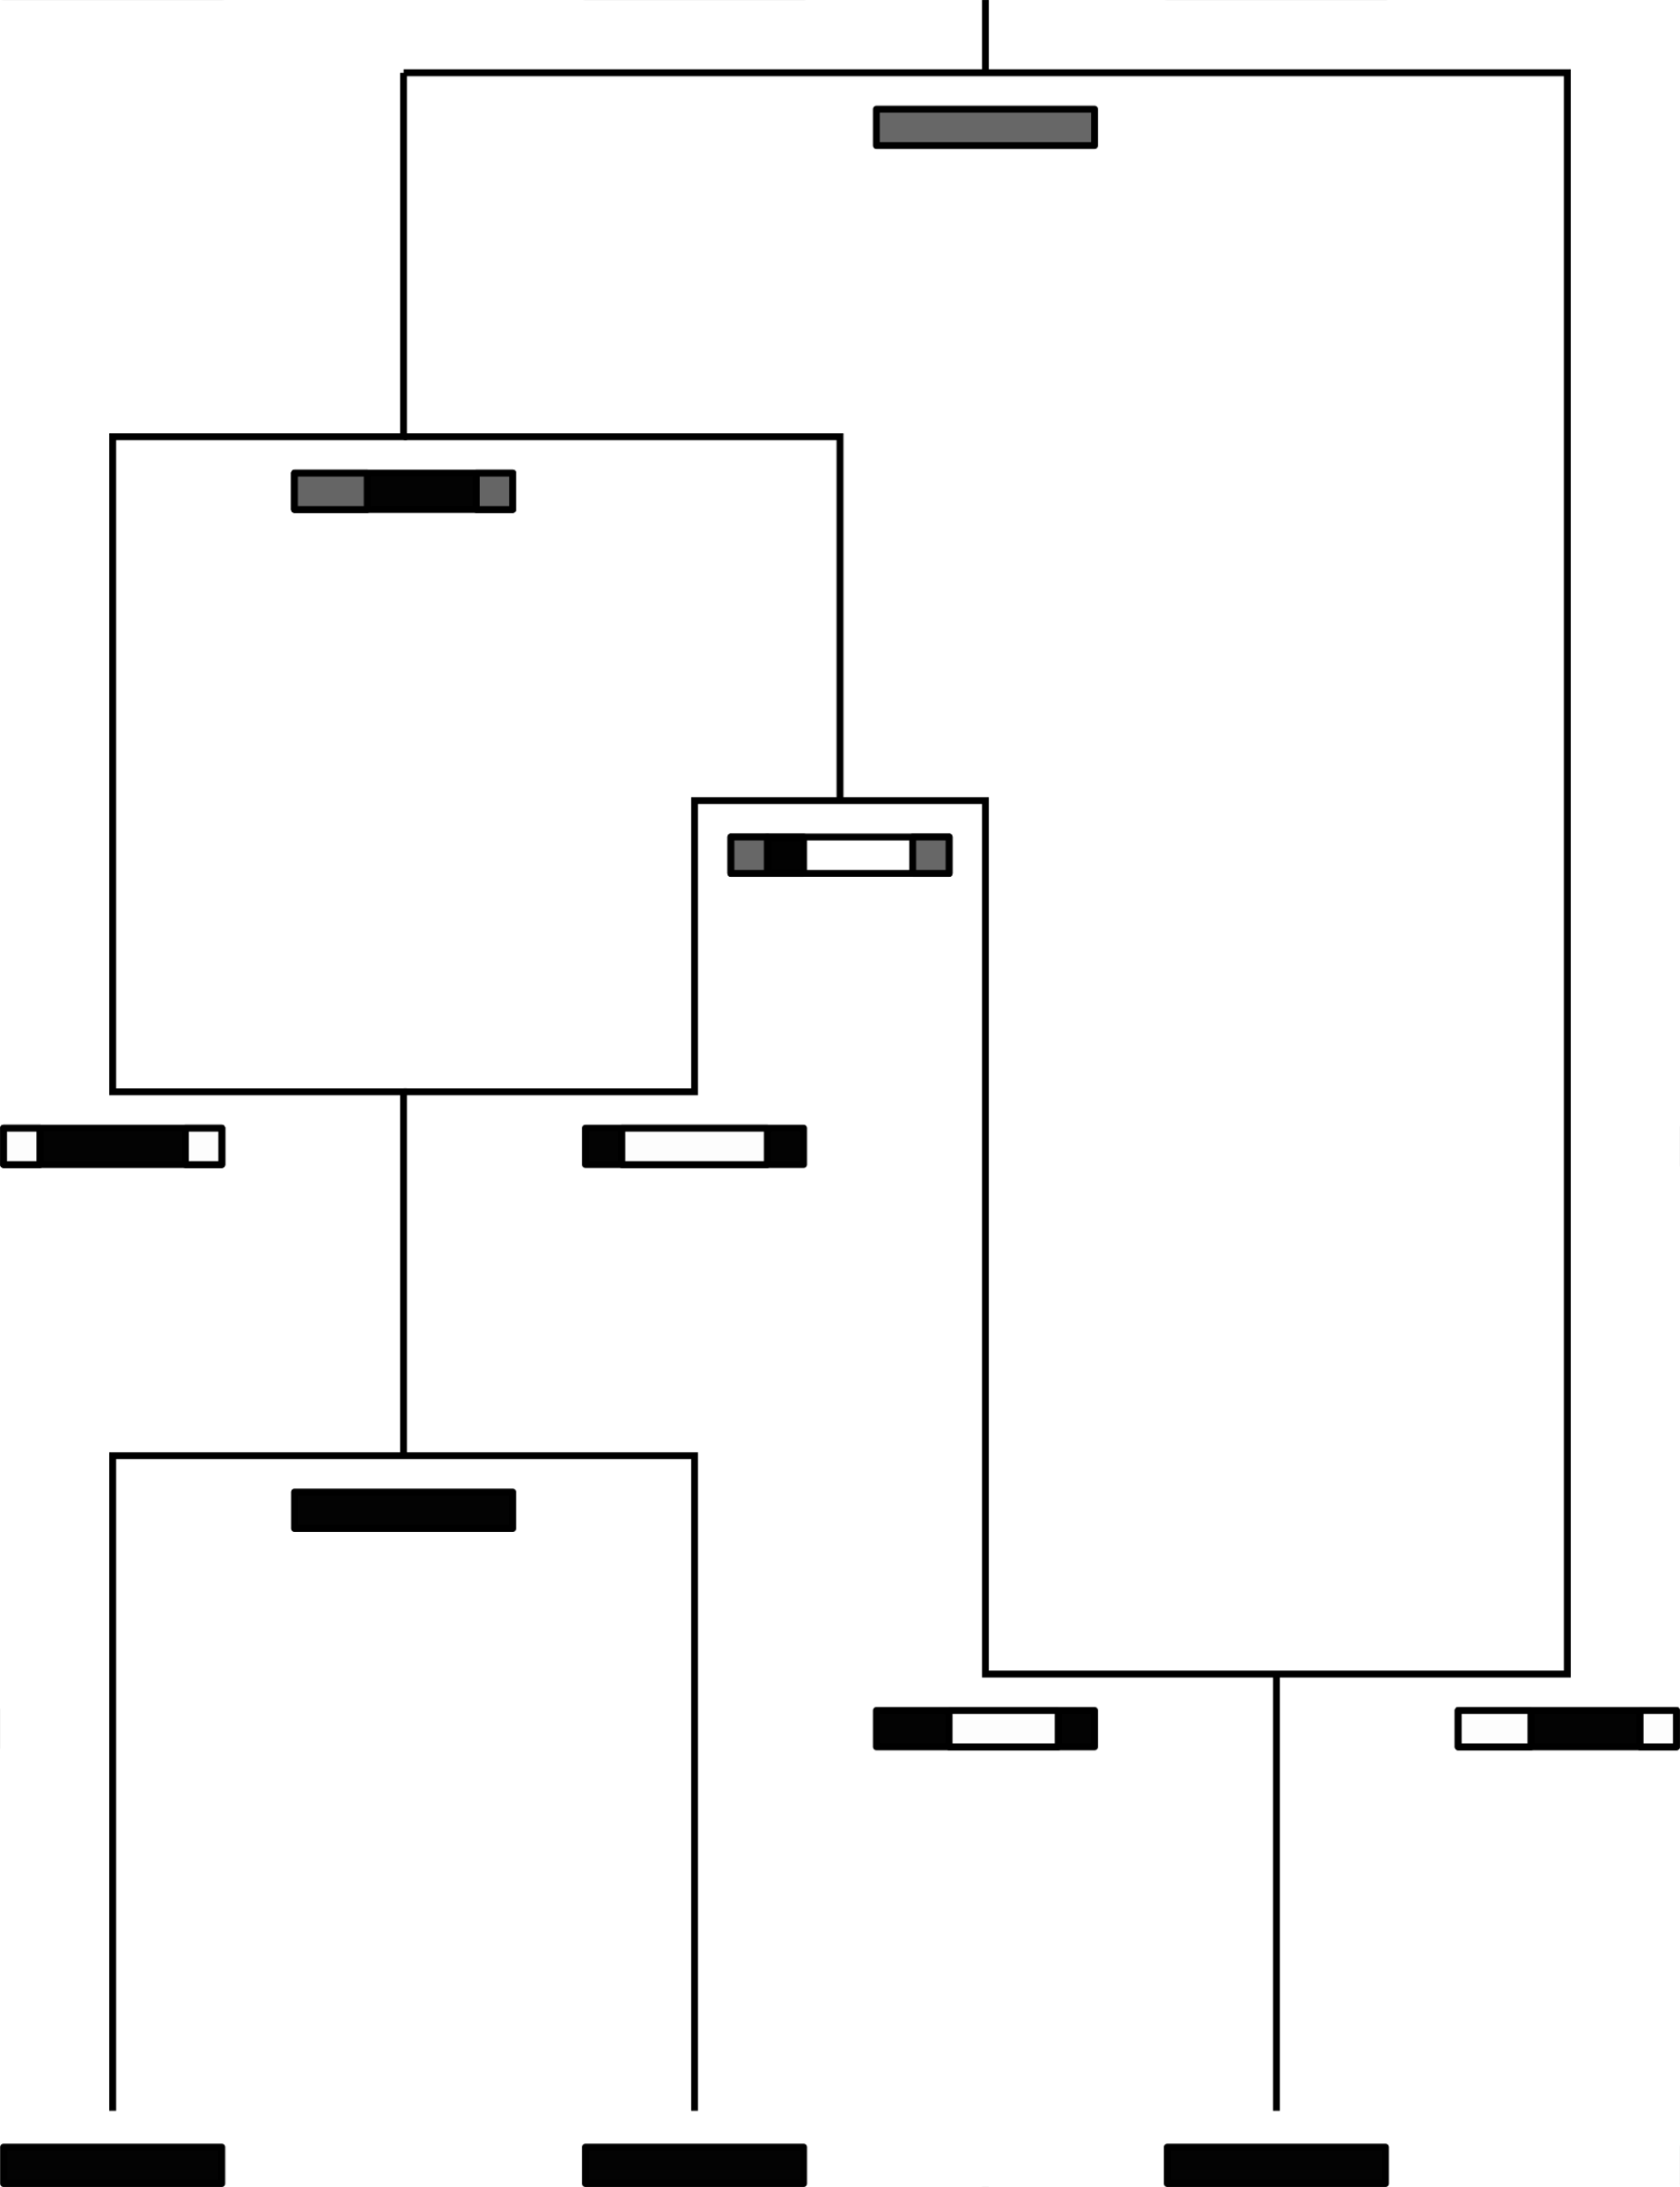
The coalescent with gene conversion models how lineages coalesce (Wiuf and Hein, 2000)
Coalescent rate is given by 1/Ne
Gene conversion rate is r
Gene conversion happens at random site and for elements of random length
Slide from Tim Vaughan

Slide 19
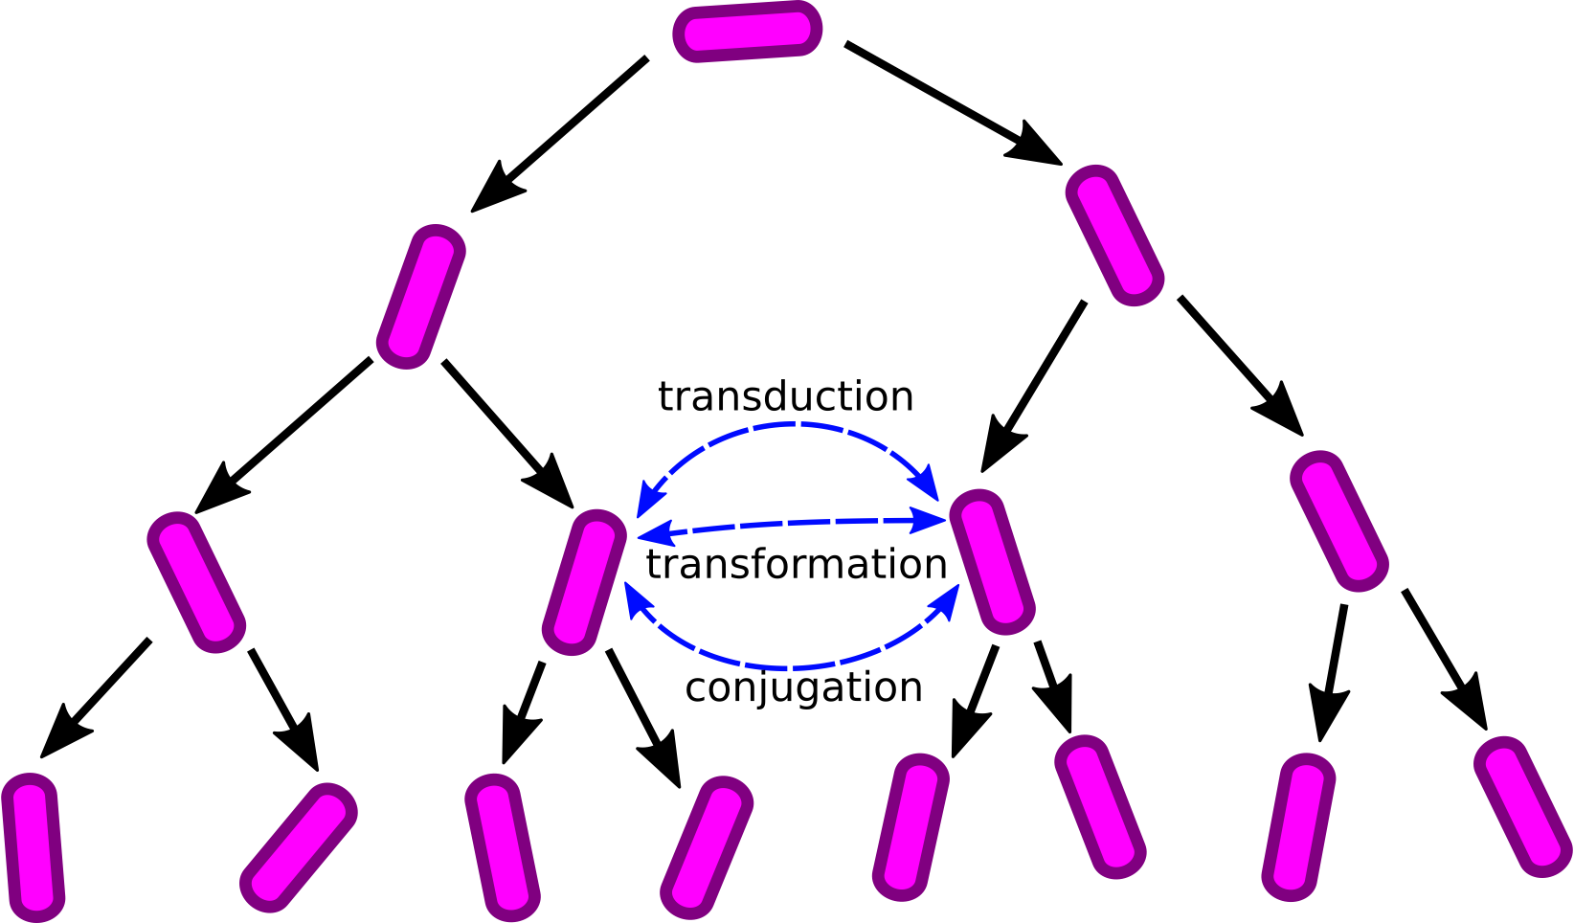
The coalescent with gene conversion can be use to model the exchange of genetic material between bacteria
Slide from Tim Vaughan

Slide 20
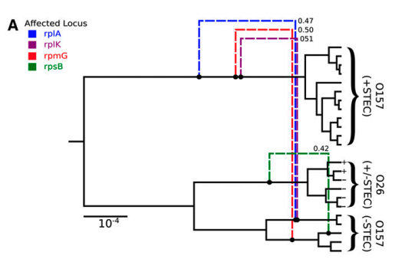
Ancestral recombination graphs for the coalescent with gene conversion can be inferred in BEAST2 using Bacter
Allows to estimate tree-based networks that have a base tree and edges that detach and re-attach directly to that base tree
Requires the assumption that only a small part of the genome is subject to recombination

Slide 21
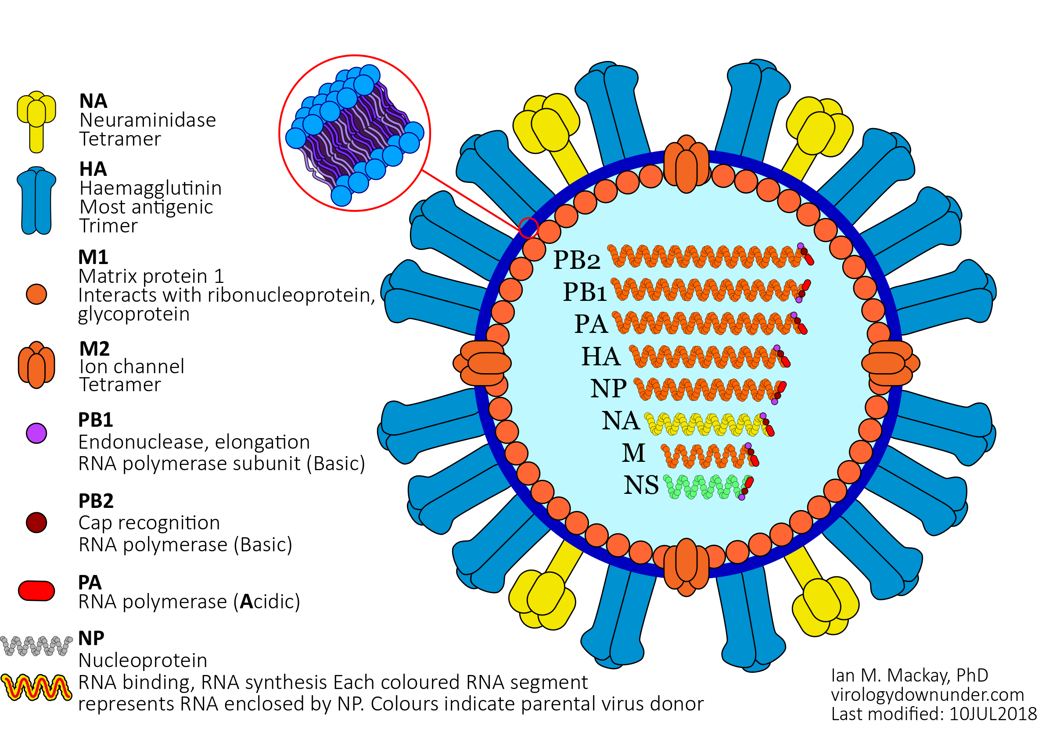
The genome of Influenza consists of several segments
Mackay, I. M.. Influenza virus. (2018). doi:10.6084/m9.figshare.6817112.v1

Slide 22
Reassortment can create progenitors with segments that originate from different parents
McDonald et al., 2016, Nat. Rev. Micr.

Slide 23
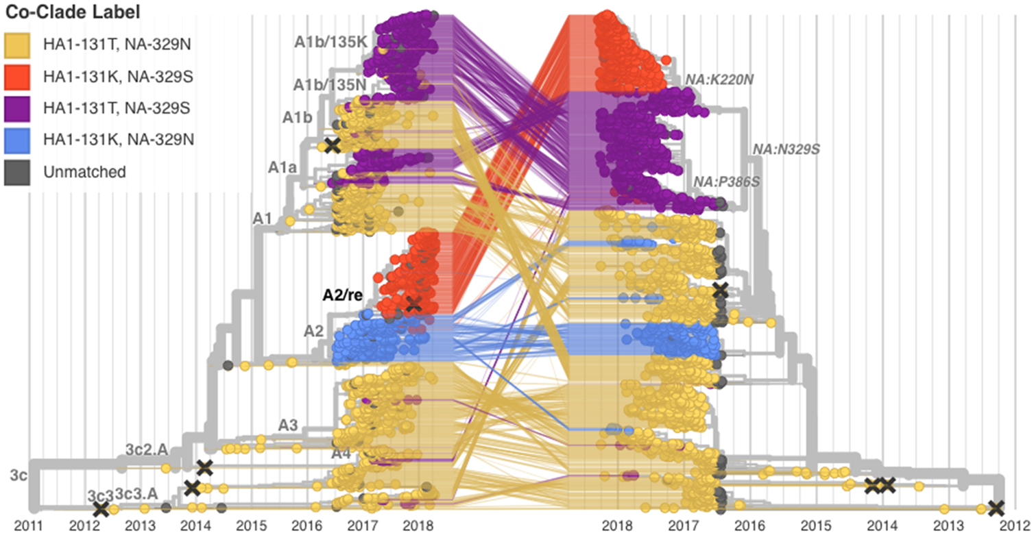
Segmented viruses can reassort, leading different segments to code for different trees
Potter et al. (2019), Virus Evol.

Slide 24
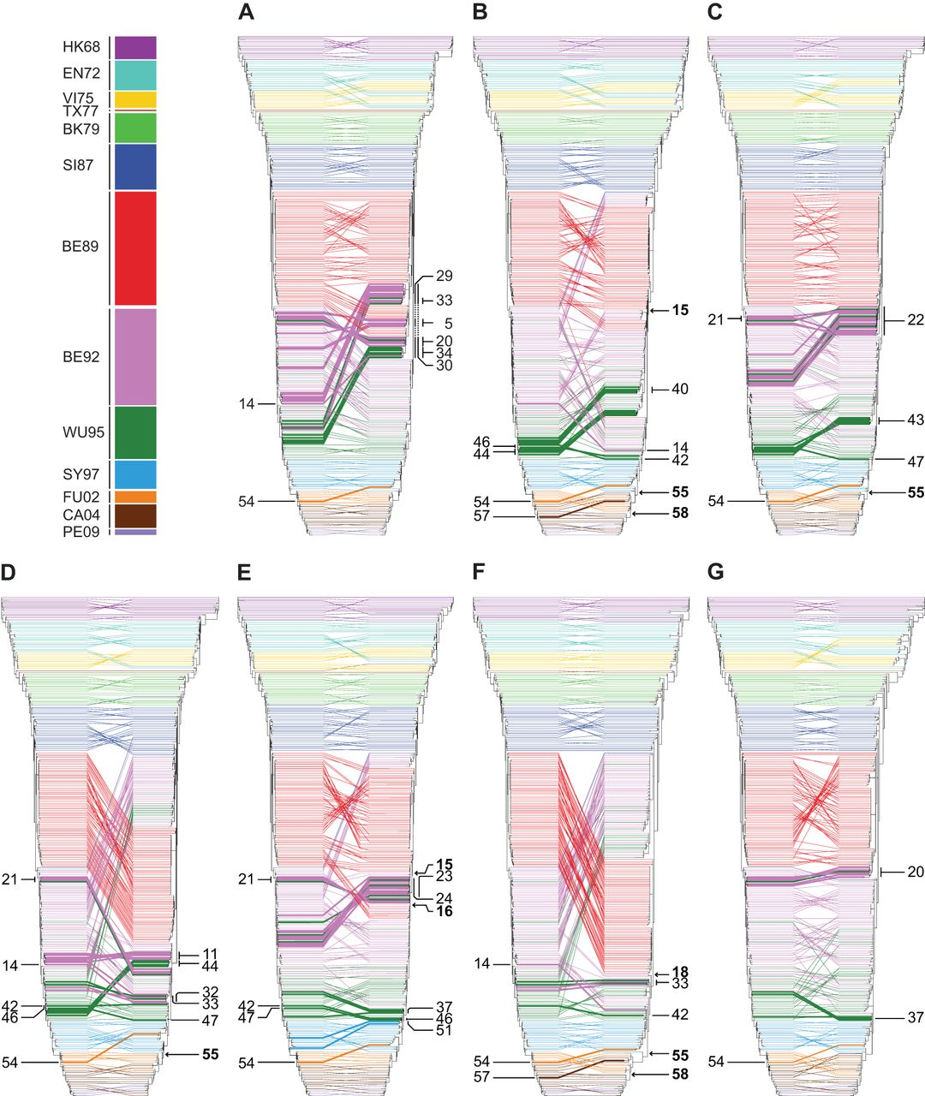
Tanglegrams can give insight into the reassortment process
Westgeest, K. D. et al. (2014),
Journal of Virology

Slide 25
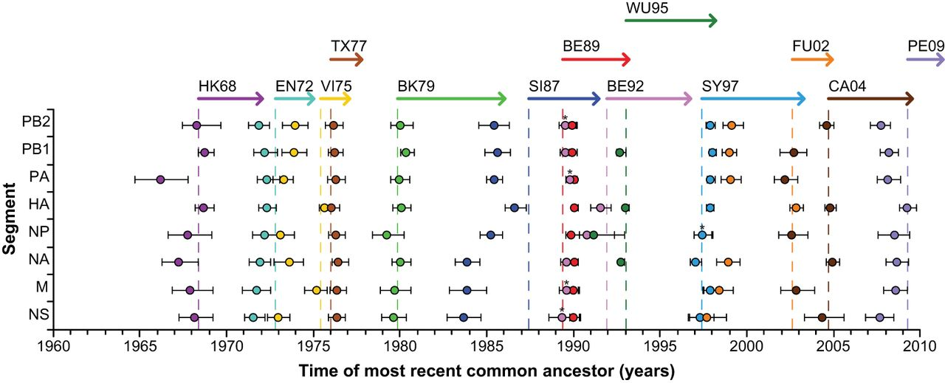
So can comparing tMRCA’s between different segment.
Westgeest, K. D. et al. (2014),
Journal of Virology

Slide 26
The coalescent with reassortment allows to model a joint coalescent and reassortment process
Müller et al. (2020), PNAS

Slide 27
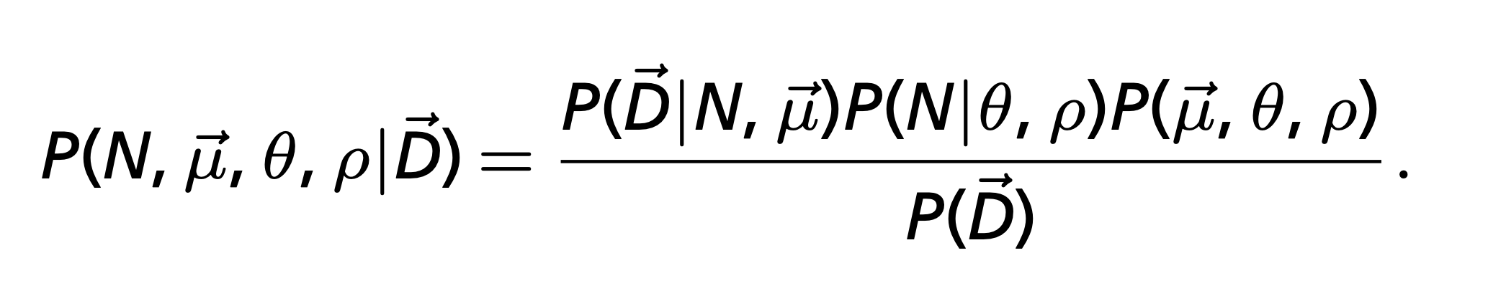
Everywhere where there was a tree, there is now a network
Müller et al. (2020), PNAS

Slide 28
CoalRe allows inferring reassortment networks, reassortment rates etc. jointly
Müller et al. (2020), PNAS

Slide 29
Correctly modelling the reassortment process impact precision and reduces bias
Müller et al. (2020), PNAS

Slide 30
QUESTIONS?

Slide 31
Some reading material
Coalescent with recombination: https://doi.org/10.1016/0040-5809(83)90013-8
Coalescent with gene conversion: https://www.genetics.org/content/155/1/451.short
ARG’s for bacteria: https://www.genetics.org/content/205/2/857
Coalescent with reassortment: https://www.pnas.org/content/early/2020/07/02/1918304117

